Slide 1

AMRUTVAHINI COLLEGE OF ENGINEERING, SANGAMNER
DEPARTMENT OF COMPUTER ENGINEERING
2024-2025
Presentation on
SmartSecure: Security Assessment of Smart Home using AI
Prepared by:
Group Id-A-06
Ms. Gilatkar Ishita Bhaskar. (Roll No.4144
Ms. Khatal Vaishnavi Devidas (Roll No.4159 )
Ms. Khose Vaishnavi Sunil. (Roll No.4160 )
Ms. Hase Sakshi Janardan. (Roll No.4149 )
Guided by: Project Coordinator: H.O.D:
Ms. K. U. Rahane Dr. D. R. Patil/ Dr. R. G. Tambe Dr. S. K. Sonkar

Slide 2
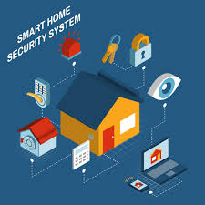
Introduction :
The rise of smart home devices has brought new security risks that traditional methods can’t easily handle. This project aims to create an AI-based system to find and fix these security issues, providing real-time protection and adapting to changing threats in smart home settings.
The rise of smart home devices has brought new security risks that traditional methods can’t easily handle. This project aims to create an AI-based system to find and fix these security issues, providing real-time protection and adapting to changing threats in smart home settings.
Problem statement :
SmartSecure: Security Assessment of Smart Home using AI

Slide 3
Abstract :
Keywords:
Home automation
Home security system
Door Security
Artificial Intelligence
Machine Learning
Creating lower cost security system
Improve safety and security of home
To address various problems

Slide 4
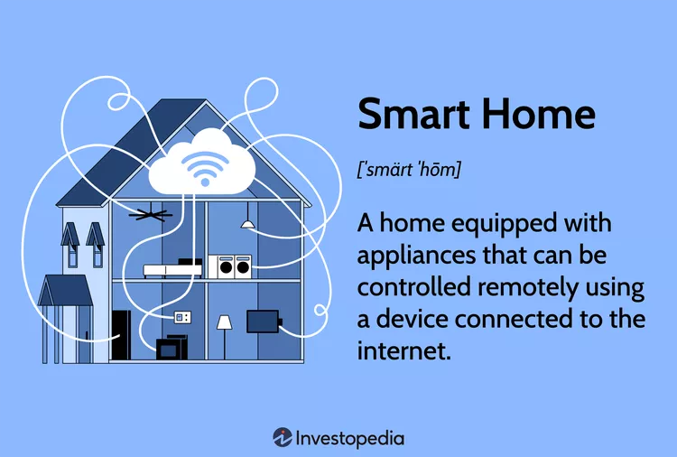

Slide 5

Domain and sub-domain :
Artificial Intelligence
Home Automation
Internet of Things (IoT)
Cyber Security.

Slide 6
Motivation
The rise of smart homes brings both convenience and new security challenges.
Traditional security methods often fall short against the complex threats targeting these systems.
The "Security Assignment of Smart Home using AI" project aims to utilize AI to build a robust and adaptive security framework, enhancing real-time data analysis, anomaly detection, and response efficiency to protect against cyber-attacks and unauthorized access.

Slide 7
Objectives :
To understand basic concept of AI.
To understand basic concept of providing security.
To collect dataset related with smart home system.
To design smart home surveillance system using AI.
To implement hardware system for Smart Home Security using AI and IOT.

Slide 8
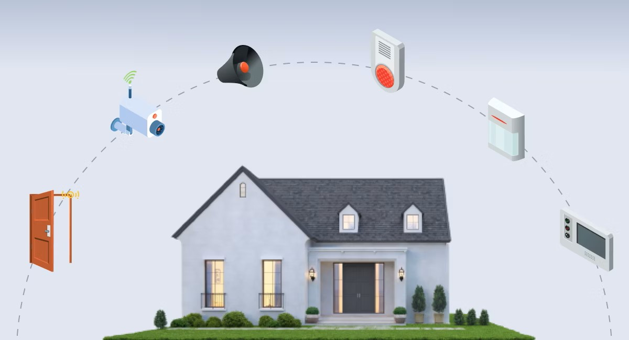
Outcome of the Project
User Privacy
Validation and Reliability
Focus on Security and Privacy
We can provide a maximum security system at minimum cost.

Slide 9
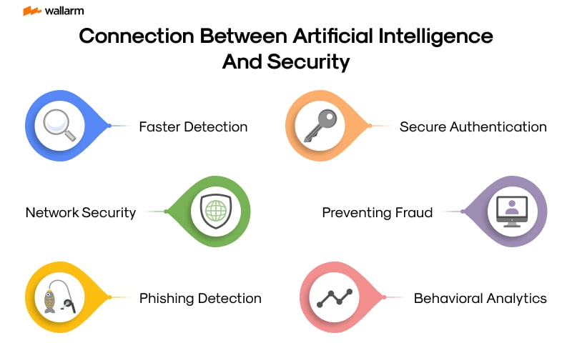

Slide 10
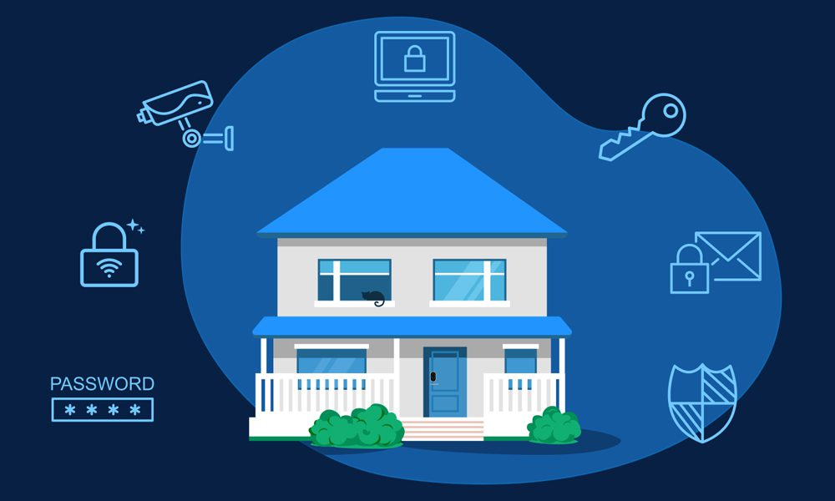
List of Modules
Admin
Registration
GSM Module
Sensor Module
Alarm Module
Notification Module
User Interface Module

Slide 11
Advantages
Drawbacks
Privacy Concerns
Complexity and Maintenance
Dependence on Internet Connectivity
False Positives and Negatives
Automated Response Systems
Improved Accuracy and Efficiency
Enhanced Threat Detection
Integration with Smart Devices
Remote Monitoring and Control
Cost-Effective Solutions
24/7 Surveillance
Customized Security Protocols

Slide 12
Hardware and software requirement
Software:
1. Voice Recognition Software
2. Security and Privacy Tools
3. Natural Language Processing (NLP) Frameworks
Hardware:
1. Sensors and Actuators
2. Smart Home Personal Assistant Devices
3. Networking Equipment

Slide 13
Literature survey
Ghadekar, P., Pradhan, M.R., Swain, D. and Acharya, B., 2024. EmoSecure: Enhancing Smart Home Security with FisherFace Emotion Recognition and Biometric Access Control. IEEE Access.
Tay, S.W., Zhang, N. and AlJanah, S., 2024. A Problem Analysis of Smart Home Automation: Toward Secure and Usable Communicationbased Authorisation. IEEE Access.
Zhang, L., Li, Z. and Zhao, Y., 2023. Research on Intelligent Home and Security Risk Warning System. International Journal of New Developments in Engineering and Society, 7(2).
Gehani, H. and Rathkanthiwar, S., 2024. AI-Based Smart Surveillance System: A Paradigm Shift in Security for Women and Beyond. In Impact of AI on Advancing Women’s Safety (pp. 1-13). IGI Global.
Majumder, A.J.A., Veilleux, C.B. and Miller, J.D., 2020. A cyber-physical system to detect IoT security threats of a smart home heterogeneous wireless sensor node. IEEE Access, 8, pp.205989-206002

Slide 14
Conclusion
Enhancements: AI improves smart home security with advanced threat detection and automated responses.
Concerns: Privacy and cybersecurity issues need careful management.
Future Potential: AI-driven systems promise significant advancements for future home security innovations.
Cost :Maximum security with minimun cost
Model :Combination of different security model
Security :We can provide proper security in our smart home
systems promise significant advancements for future home security innovations.

Slide 15


